Slide 1
Vietnamese – German University (Foundation Year) Computer Science English Class Mr. Richard

Slide 2
Tourism Website Proposal Presentation
Quách Trí Thông – Nguyễn Tuấn Kiệt – Nguyễn Thành Long – Kiều Hoàng khôi
TEAM 3 (group A, B)

Slide 3
1. Background
2. Requirements
3. Constraints
4. Schedule
5. Conclusion

Slide 4
1. BACKGROUND
The increase in standard of living => the increase in entertainment demands
Traditional booking: time-consuming, inconvenient
Customers’ need: all-in-one tourism service
Online booking: instant booking, online payment, multiple options

Slide 5
2. REQUIREMENTS
Simple interface
Time-saving design
Real-time booking system
Preference suggestion
Customer feedback
24/7 support

Slide 6
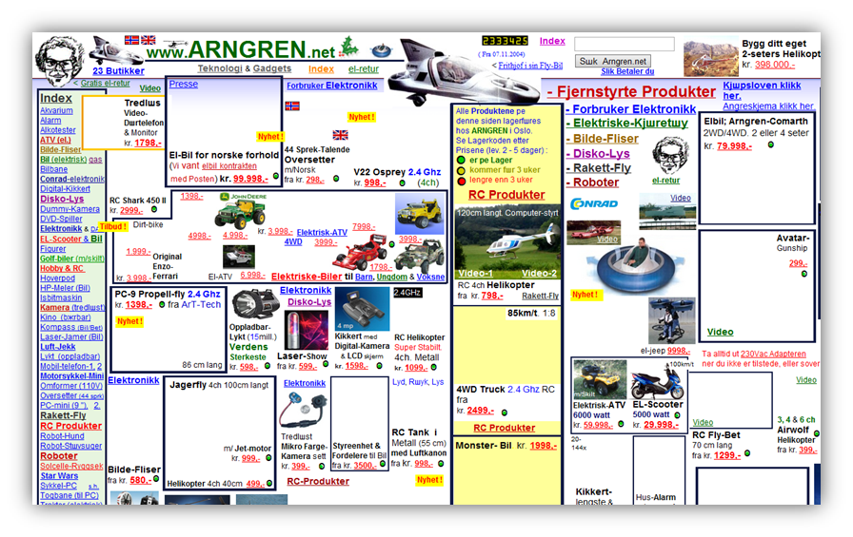
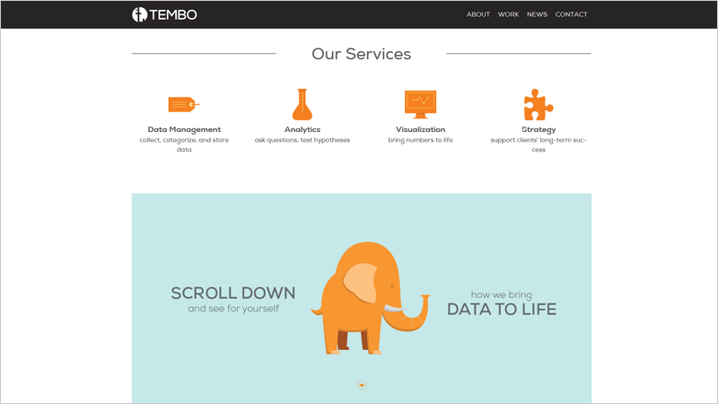
SIMPLE INTERFACE:
Visual website and easy navigation

Slide 7
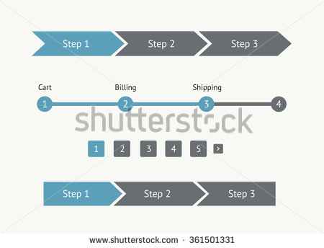
Time-saving design:
useful information
simplest and fastest booking steps
1. Choose a tour
2. Choose accommodation and
additional services …
3. Fill information form
4. Pay

Slide 8
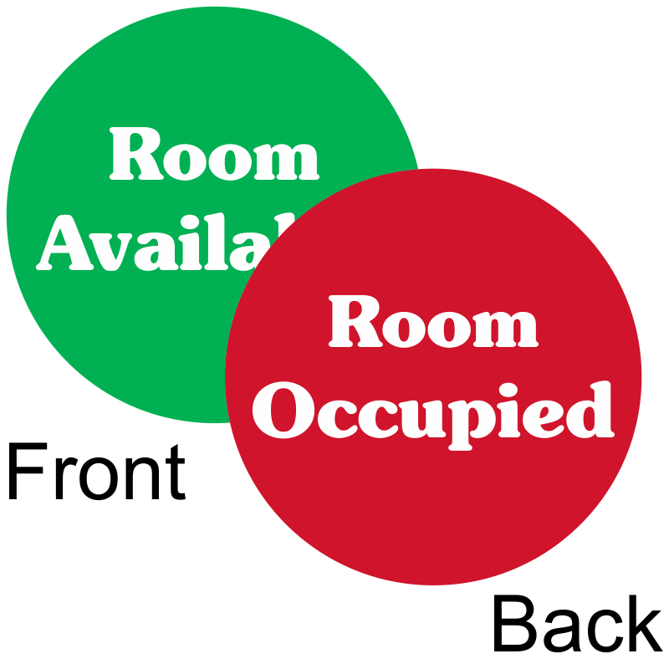
Real-time booking system
real-time tour’s status (available or occupied)

Slide 9

Preference suggestion
suggest appropriate tours for user

Slide 10

Customer feedback:
comment box below each tour

Slide 11


24/7 support:
Online support and phone support

Slide 12
3. CONSTRAINTS
Not mobile-friendly design.
Unable to provide a step by step booking.
Can’t create a fixed navigation bar.
Difficulty in translating name of traditional foods.

Slide 13
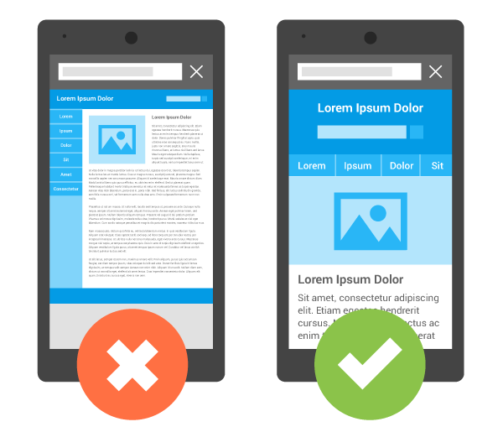
Not mobile-friendly desgin

Slide 14
Unable to provide step by step booking

Slide 15
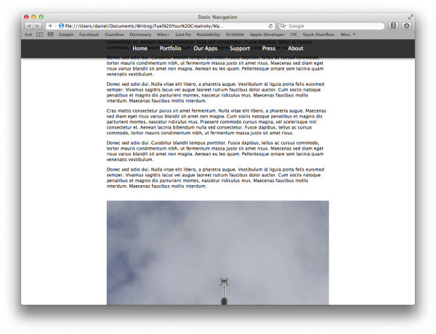
Can’t create a fixed navigation bar

Slide 16
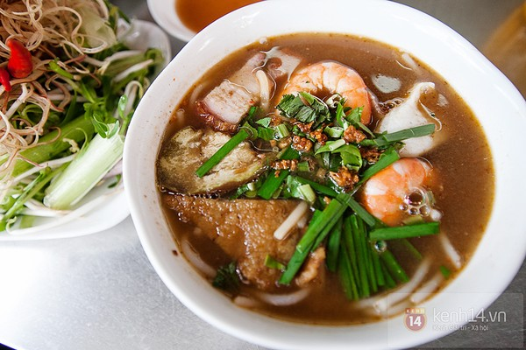
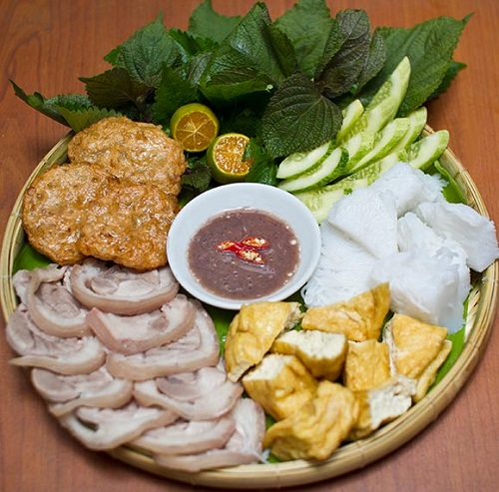
Difficulty in translating name of traditional foods.

Slide 17
4. DEVELOPMENT SCHEDULE

Slide 18
1st Week
Sketch out the sitemap and then finish the storyboard.
Make a mockup (annotated diagram).

Slide 19
2nd Week
Code the framework of the website based on the mockup (pages are linked already).

Slide 20
3rd Week
Collect information from the internet and categorize them.
Put the information collected into the website.

Slide 21
4th Week
Finish small details to have a beta website.
Ask somebody for advices to improve our website.

Slide 22
5th Week
Check all the details to find errors remaining.
Ready to use the website.

Slide 23
5. CONCLUSION
Everything is done online + increase in travelling demand
=> Online booking would save time & money.

Slide 24
THANKS FOR YOUR LISTENING!

